Slide 1
NAME
RAHUL M

Slide 2
Let AI Take the Wheel: A Joyride Through Self- Driving Car Simulation

Slide 3

AGENDA
PROBLEM STATEMENT PROJECT OVERVIEW
MY SOLUTION AND ITS VALUE PROPOSITION THE WOW IN MY SOLUTION
MODELLING
RESULTS

Slide 4

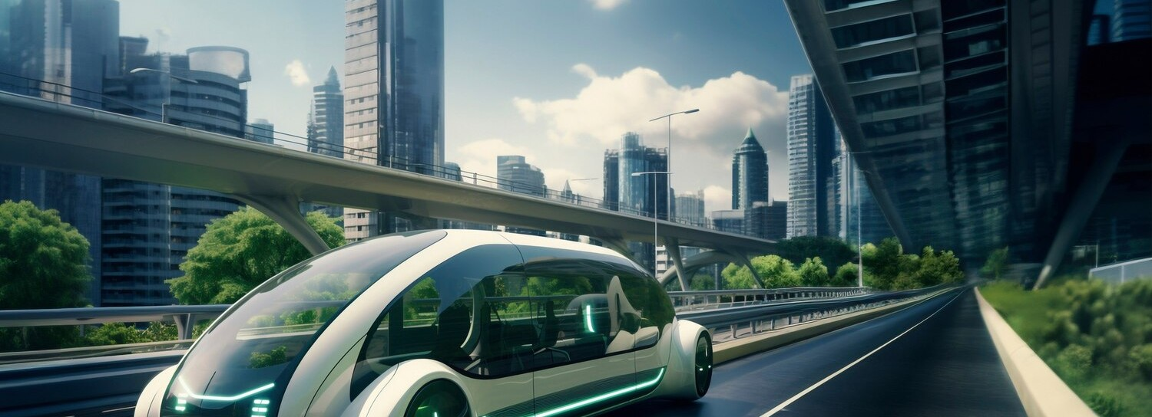
PROBLEM STATEMENT
Develop an autonomous driving system for a virtual environment. Utilize sensors like cameras, lidar, and radar to make real-time driving decisions, including lane following, trafﬁc signals, pedestrian detection, and obstacle avoidance, ensuring safe navigation.

Slide 5

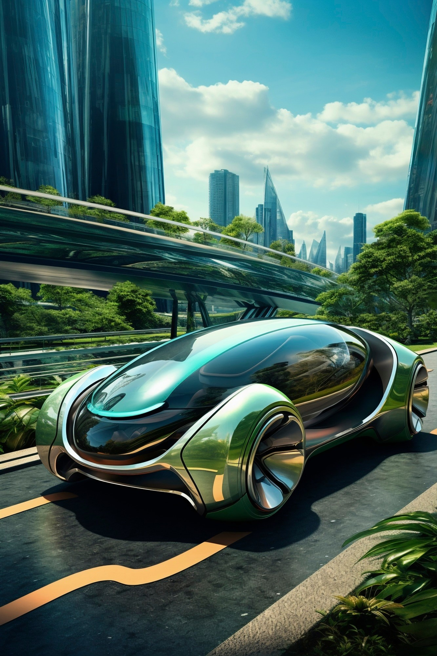
PROJECT OVERVIEW
The project involves creating an autonomous driving system for a simulated environment. This system will use sensors like cameras, lidar, and radar to make real-time driving decisions such as lane following, trafﬁc signal interpretation, pedestrian detection, and obstacle avoidance. The goal is to ensure safe and efﬁcient navigation in various driving scenarios within the virtual environment.

Slide 6


WHO ARE THE END USERS?
The end users of the autonomous driving system project could include researchers, developers, and companies working in the ﬁeld of autonomous vehicles.

Slide 7
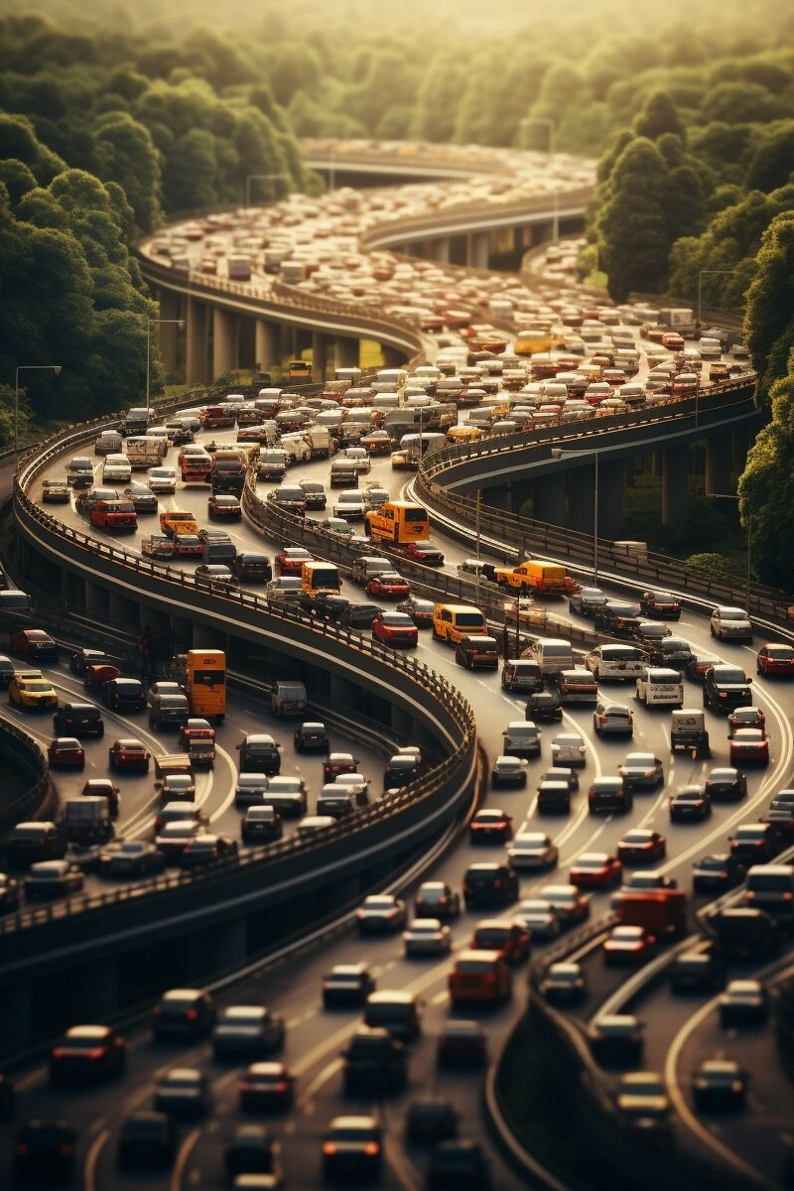
MY SOLUTION AND ITS VALUE PROPOSITION
Develop an autonomous driving system for a simulated environment using sensors and advanced algorithms. This system aims to improve safety, increase efﬁciency, drive innovation, and reduce costs in transportation.

Slide 8

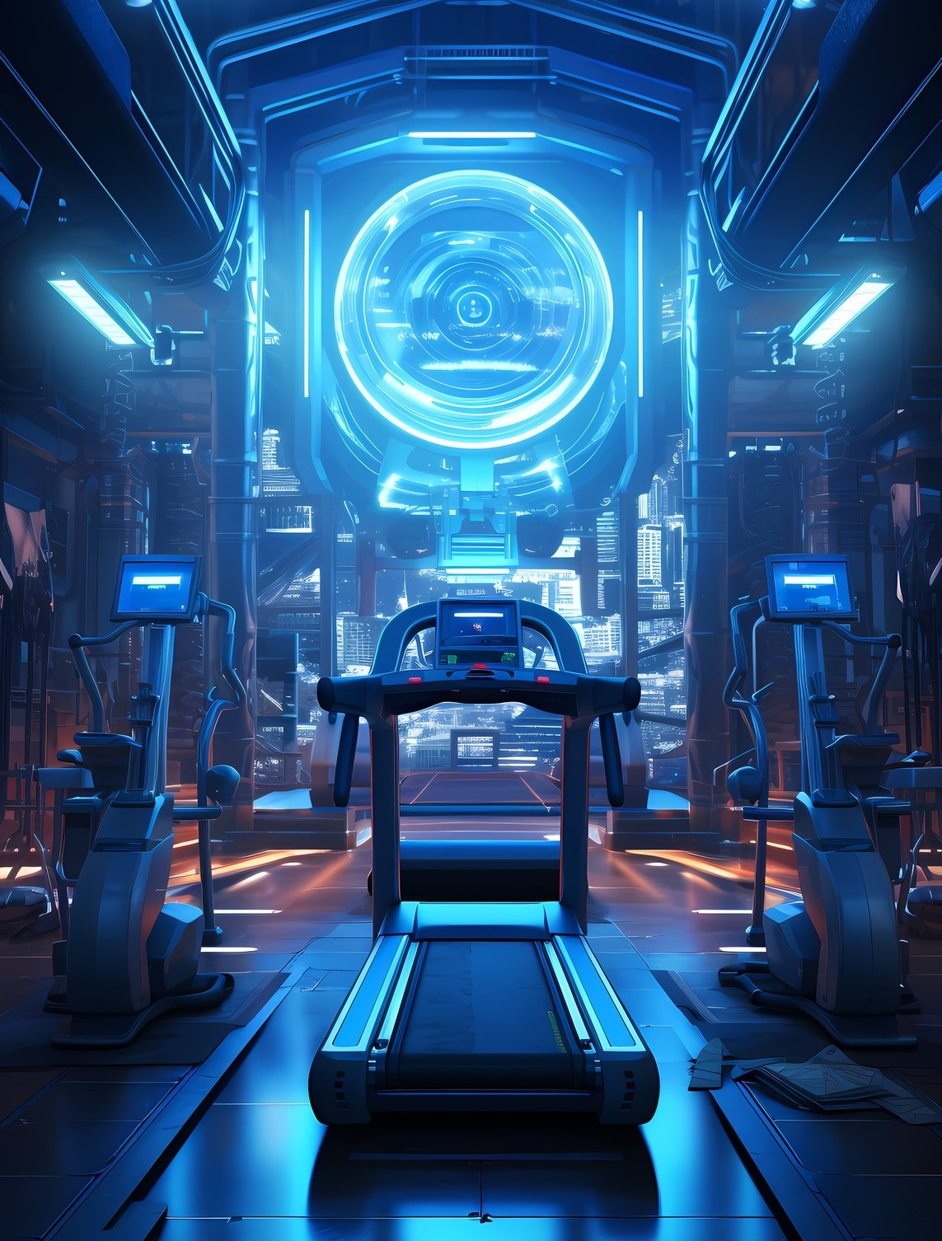
THE WOW IN MY SOLUTION
The wow factor in the solution is its capability to create an autonomous driving system that can operate effectively in a simulated environment, showcasing advanced sensor integration and algorithmic sophistication. This not only demonstrates cutting-edge technology but also has the potential to revolutionize the automotive industry by paving the way for safer, more efﬁcient, and cost-effective transportation systems.

Slide 9

MODELLING
The modeling approach involves creating sophisticated neural network architectures for perception, decision- making, and control tasks, including CNNs for image processing, RNNs/LSTMs for sequential data, and reinforcement learning algorithms. This approach showcases advanced technology for mimicking human- like driving behavior in the simulated environment.

Slide 10

RESULTS
The results will showcase the system's autonomous navigation in the simulated environment, including lane following, trafﬁc signal interpretation, pedestrian detection, and obstacle avoidance. These outcomes highlight the system's potential for real-world implementation in autonomous driving technology.

